Slide 1
Cloud, Composability and Beyond: Building the Bank of Tomorrow
Jinhong Brejnholt

Slide 2
Abstract – 15 mins keynote
In the rapidly evolving world of financial technology, Saxo Bank has been at the forefront of innovation by embracing a "Cloud First" strategy. This journey began with a commitment to leverage the scalability and flexibility of cloud computing, allowing us to meet the dynamic needs of our clients. As we progressed, our strategy naturally evolved into a "Cloud Native First" approach, integrating the principles of cloud-native architecture to further enhance our operational efficiency and agility.
Throughout this transformation, we have placed a strong emphasis on adopting open-source software while maintaining strict security and compliance governance. This has enabled us to shift towards a modular software architecture, moving away from monolithic and tightly coupled systems. By learning from our experiences, we have developed workload modules that are not only more flexible but also more resilient.
Our journey has taught us invaluable lessons about the importance of a resilient infrastructure. We believe that building and running the bank of tomorrow requires a platform that prioritizes security, compliance, and cost-effectiveness to ensure sustainable business growth. Join us as we delve into the key insights and strategies that have shaped our path forward and explore how composability and cloud-native principles are driving the future of banking.
What’s not included in the abstract is our ongoing work on a platform architecture that will allow us to run on any cloud - both public and private - providing maximum flexibility, resilience, and cost-efficiency.

Slide 3



About Us
Online trading and investment
17 billion USD daily trade
200+ banks and brokers
1.2 million clients
DKK 816 billion in client assets
jbrejnholt
Notes:
Saxo Bank is a Danish investment bank specializing in online trading and investment. It was founded as a brokerage firm in 1992, under the name Midas Fondsmæglerselskab, by Lars Seier Christensen, Kim Fournais, and Marc Hauschildt. The name was changed to Saxo when the company obtained a banking license in 2001.
Saxo Bank A/S is a fully licensed and regulated Danish bank with an online trading platform that empowers you to invest across global financial markets.

Slide 4


AWS
jbrejnholt
Notes:
The concept of cloud computing emerged in the 1960s with the idea of shared computing resources. However, it wasn’t until the early 2000s that it truly began to take off with the launch of services like Amazon Web Services (AWS) in 2006, offering scalable, on-demand IT infrastructure. Since then, cloud computing has rapidly evolved, becoming a cornerstone of modern digital transformation, enabling businesses worldwide to innovate and scale like never before.

Slide 5





Cloud Computing Benefits
Scalable
Secure
Savings
Flexible
Innovation
jbrejnholt
Notes:
Cloud benefit ref
https://azure.microsoft.com/en-us/resources/cloud-computing-dictionary/what-is-cloud-computing/
Innovation: LB, Storage, VM, here you go, no need for Service Now ticket (I'm just kidding, you are still working for a bank)
Cloud computing is the on-demand delivery of IT resources over the internet, offering flexibility, scalability, and efficiency. By leveraging cloud services, businesses can access computing power, storage, and applications without the need for traditional on-premises infrastructure, enabling faster innovation, cost optimization, and seamless scalability to meet evolving business demands.

Slide 6

jbrejnholt
Notes:
What are we waiting for?

Slide 7




Journey
Platform v1
Platform v3
?
?
2017
2019
2021/22
2024/25
Cloud!
Platform v2
?
jbrejnholt
Notes:
Outline Saxo Bank’s commitment to open-source technologies and the transition from monolithic to modular architecture.
Discuss the benefits of composability and modularity: easier updates, scalability, and better resilience.
Mention the role of Kubernetes and other open-source tools in supporting this architecture.
2020 realized cloud native != DR, Reliability => GitOps enpowed V2
All good? not quite - $, exit, cloud-agnostic => v3, in on prem DC!
Emphasize the importance of security, compliance, and governance in Saxo Bank’s journey.
Describe how open-source adoption is balanced with strict security measures and compliance requirements.
Provide examples of security enhancements implemented during this transformation.

Slide 8


jbrejnholt
Notes:
What's this nonsense, who are you anyway

Slide 9


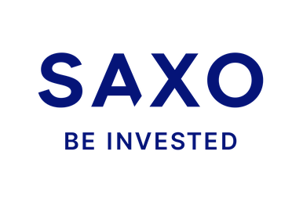

jbrejnholt

Slide 10
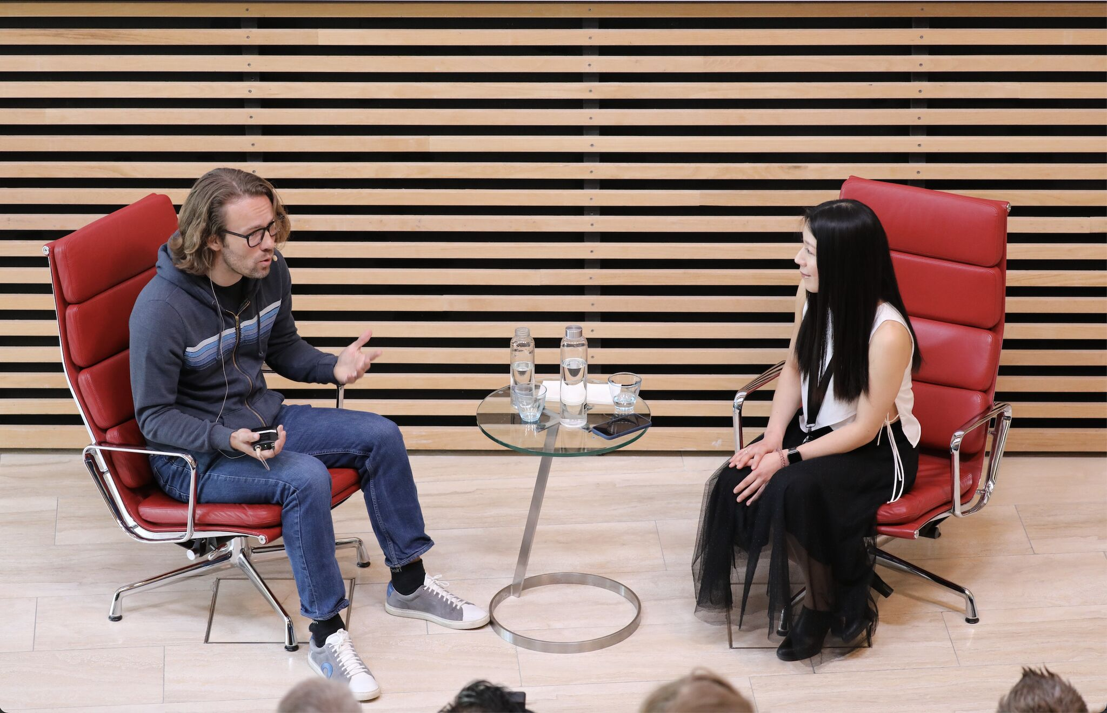
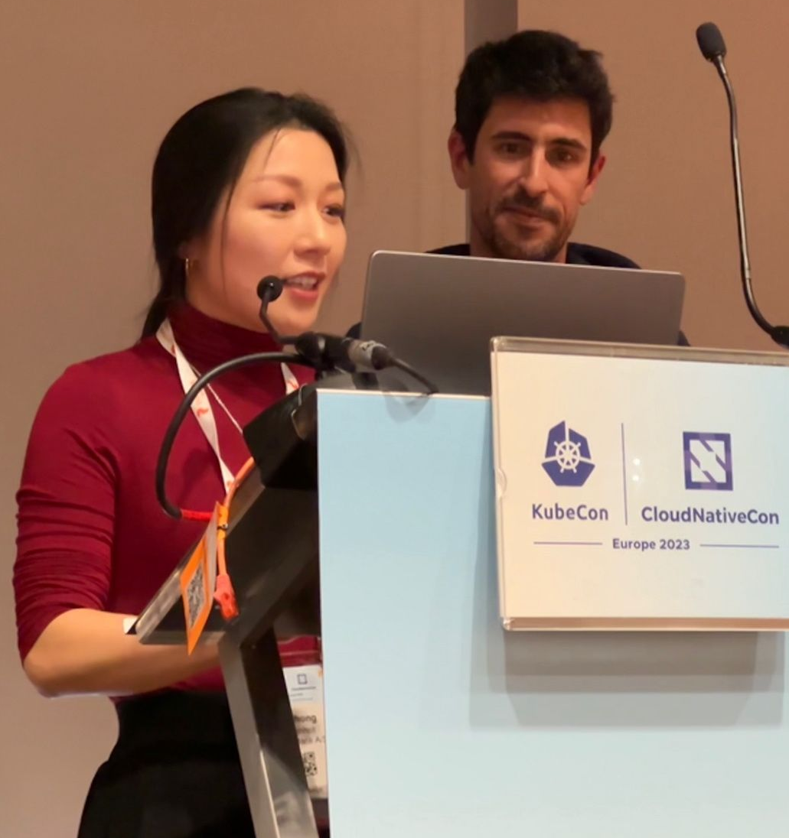
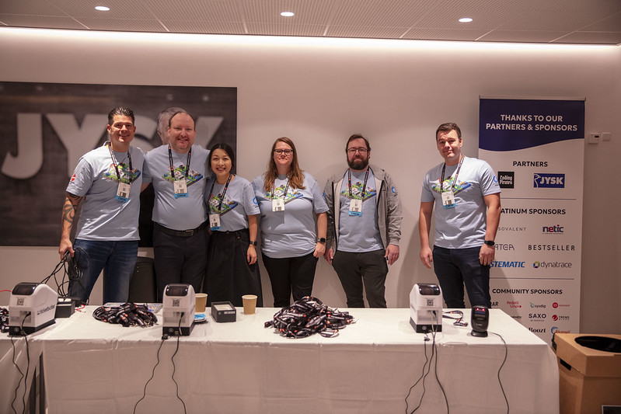
Cloud Native Community
jbrejnholt

Slide 11
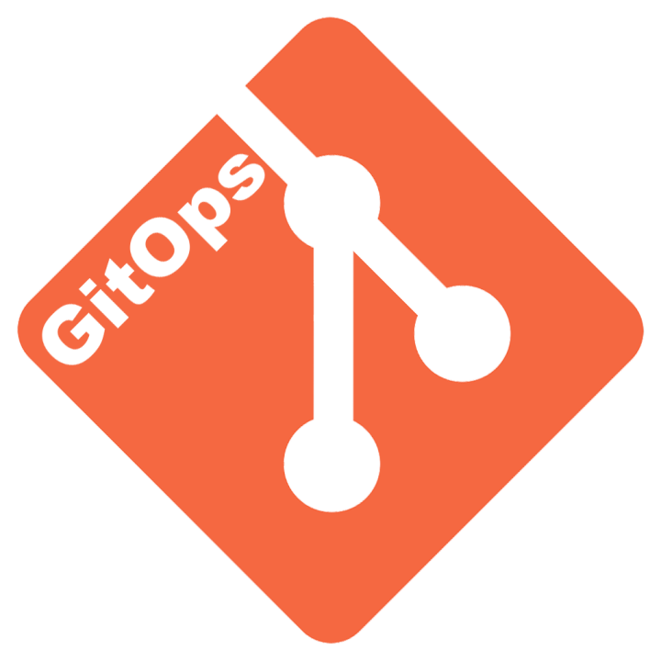


Journey
Cloud Native
Hybrid/Multi Cloud
Container/K8S
K8S Fleet
2017
2019
2021/22
2024/25
Cloud!
Cloud Agnostic
SaaS
GitOps K8S

Slide 12

Journey
Cloud Native
Hybrid/Multi Cloud
Platform v1
Platform v3
Container/K8S
K8S Fleet
?
?
2017
2019
2021/22
2024/25
Cloud!
Cloud Agnostic
Platform v2
SaaS
GitOps K8S
?
jbrejnholt
Notes:
SaaS -> better mgmt for workload -> DR, more resilient hosting platform -> Cost-efficient and flexible.
SaaS: Our cloud journey began with adopting a public cloud strategy, where we built an AKS (Azure Kubernetes Service) platform to host containerized workloads. As our capabilities matured and our business needs grew, we recognized the importance of not only greater flexibility and control but also cost efficiency.
Initially, public cloud services provided us with scalability and agility. However, as the volume of our workloads increased, so did the costs. Cloud compute becomes significantly more expensive when a company’s resource demands reach a certain scale. While the cloud offers undeniable benefits such as fast provisioning and global reach, we found that it can be more cost-effective to run workloads on-premises using our own hardware.
Rather than being tied to a single cloud provider, we embraced a cloud-agnostic approach. Using Kubernetes and ClusterAPI, we built a GitOps-driven platform capable of running anywhere—on-premises, in any public cloud, or in third-party data centers. What might seem like a “backwards” move—returning to our own data center—actually enabled us to reduce operating costs without sacrificing flexibility or scalability.
This transition allows us to enjoy the best of both worlds: leveraging cloud services where they add value, while optimizing costs by utilizing on-premises infrastructure for long-running, resource-intensive workloads. Our approach maximizes control over infrastructure spending while ensuring we remain adaptable to changing business needs.

Slide 13

jbrejnholt
Notes:
There might still be a lot of things we don't know, but we are positive that we are ready for the change should the need raises.
Share critical lessons from Saxo Bank’s transformation journey.
Importance of resilient infrastructure.
Balancing innovation with security and compliance.
The value of modularity and composability in future-proofing banking operations.

Slide 14
Cloud to Cloud Native
Multi-Cloud
Hybrid Cloud
Cloud Native
DR & Cost
Cloud-First
jbrejnholt
Notes:
Discuss how Saxo Bank’s cloud-native and composable approach is paving the way for the bank of tomorrow.
Envision a future where banking platforms are highly adaptable, secure, and cost-effective, driven by cloud-native and open-source innovations.
Our cloud journey began with a 'Cloud First' strategy, where we explored the transformative benefits of cloud-native practices — embracing API-driven, modular, and scalable architectures.
As we progressed, we learned valuable lessons and invested significantly in disaster recovery and cost optimization. These efforts have paved the way for us to build the 'Bank of Tomorrow.'
With a hybrid, and eventually multi-cloud approach, we aim to deliver a hosting environment that is cost-efficient, secure, and resilient—empowering our business to thrive in an increasingly dynamic digital landscape.

Slide 15

How is your cloud journey?
jbrejnholt
Notes:
Now the question to you - how is your cloud journey?

